Slide 1
Welcome
LiveSchool’s New Style Guide

Slide 2






Logos
Full Version
Icon Only
Full Version
Icon Only

Slide 3







Social Icons
Instagram
LinkedIn
TikTok
Twitter
Facebook
YouTube
Spotify

Slide 4





Product Icons
Points Tracking
House Points
Rewards Store
Insights
Recaps

Slide 5


Product Icons
QR Code
Printables

Slide 6






Product Icons

Slide 7
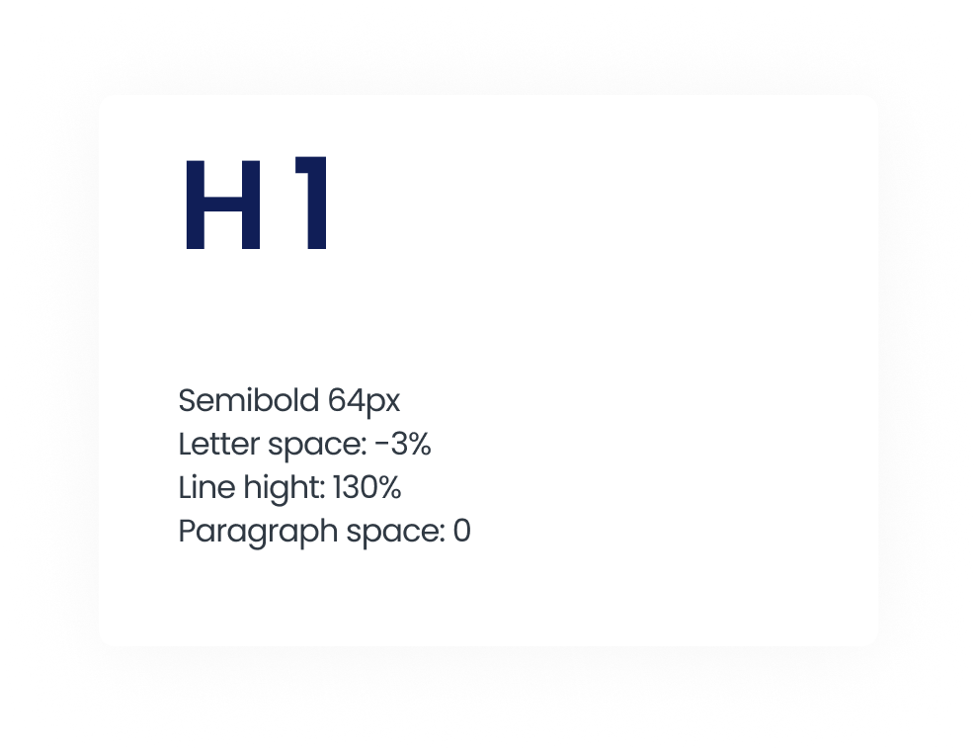
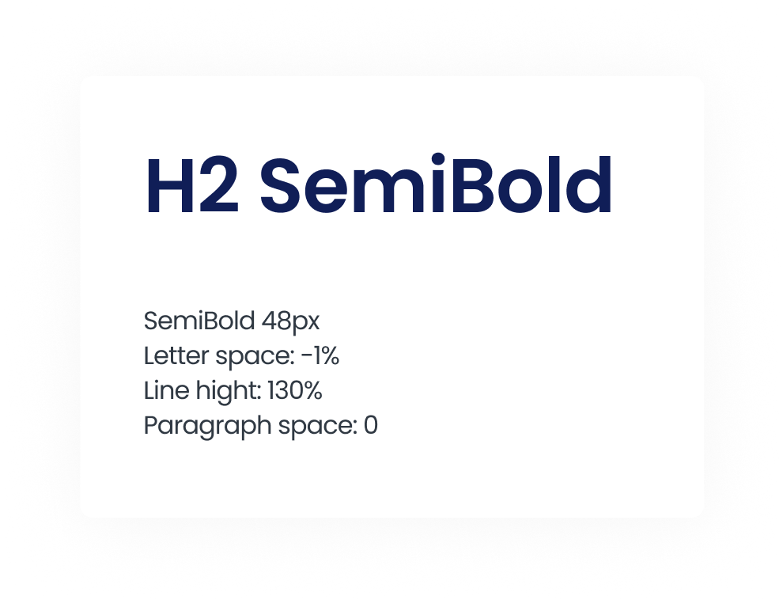
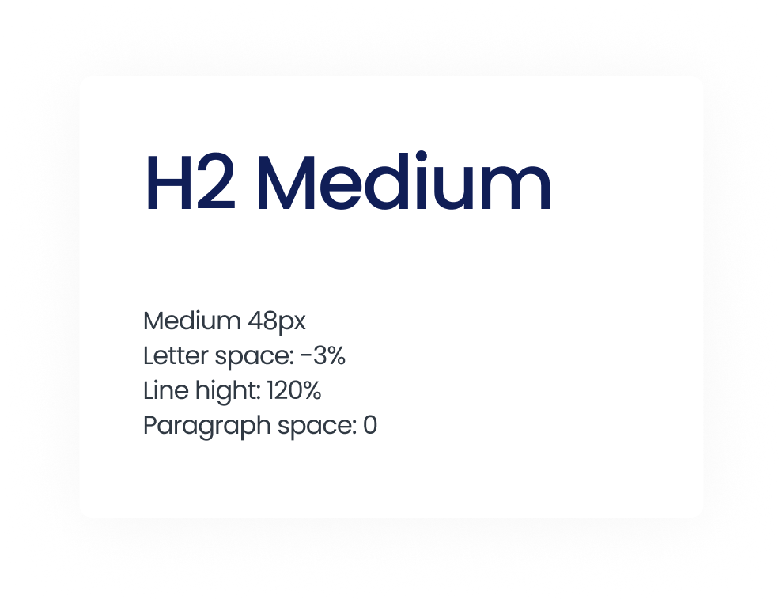
Typography
Poppins Font

Slide 8
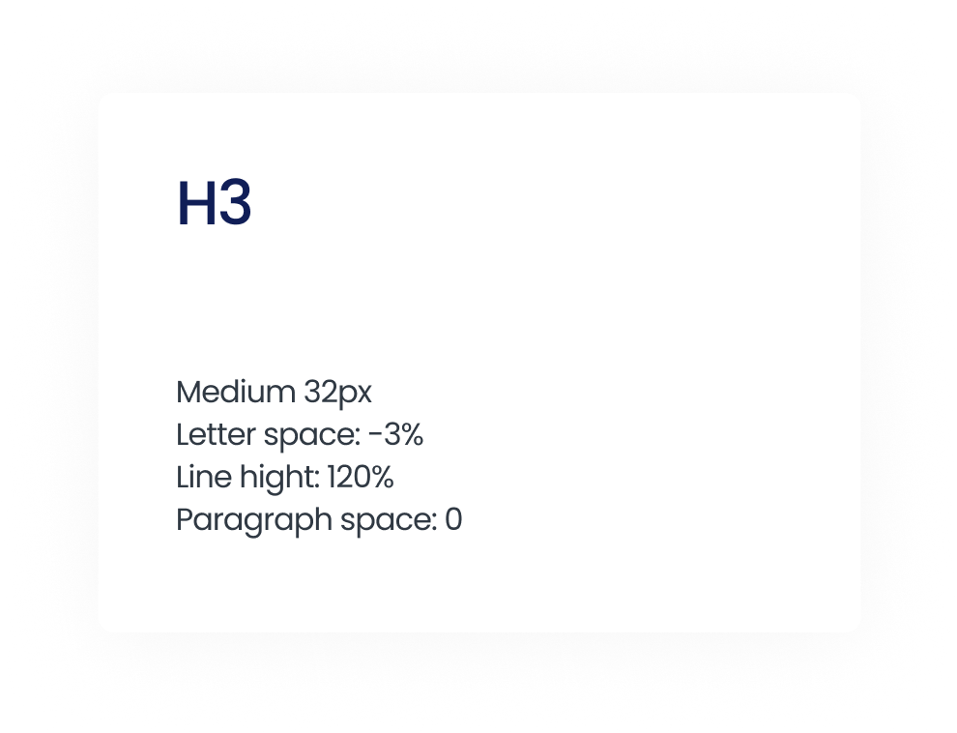
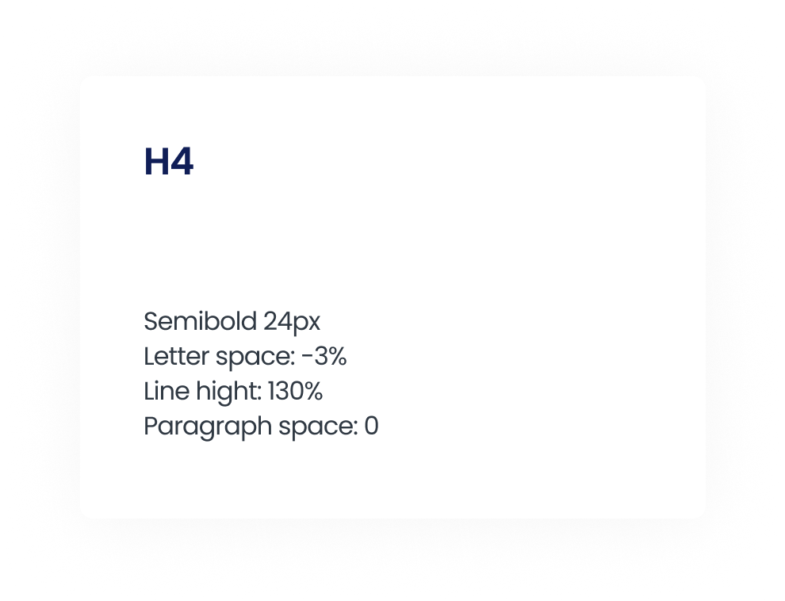
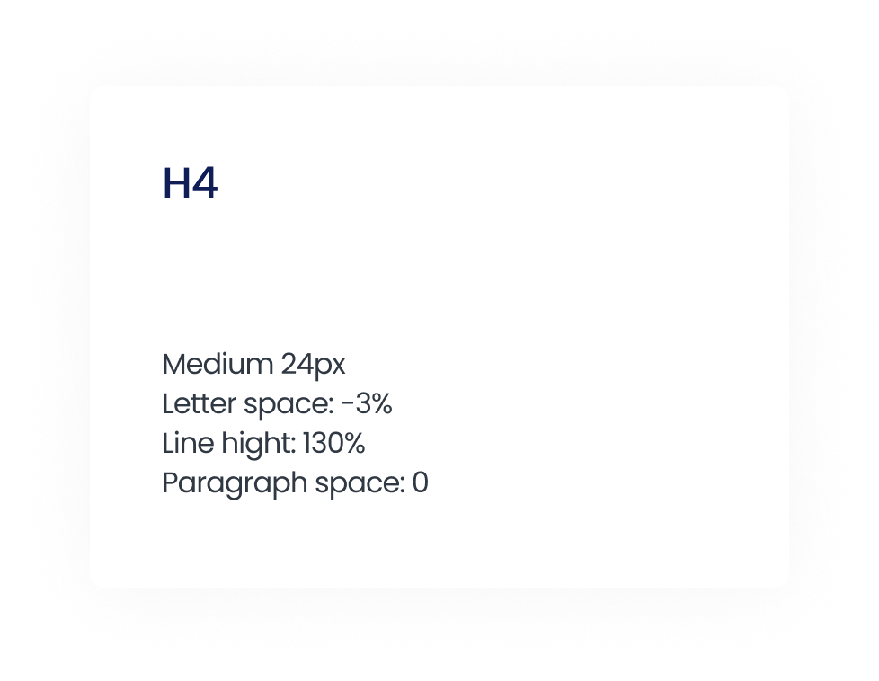
Typography
Poppins Font

Slide 9
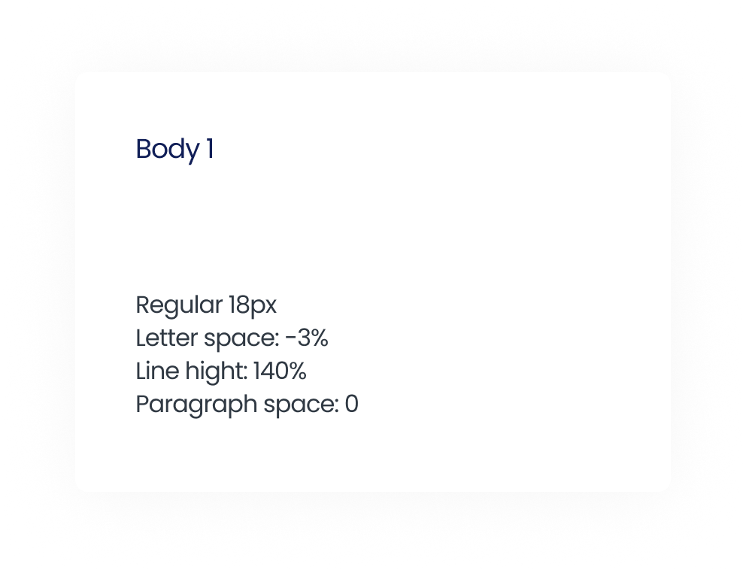
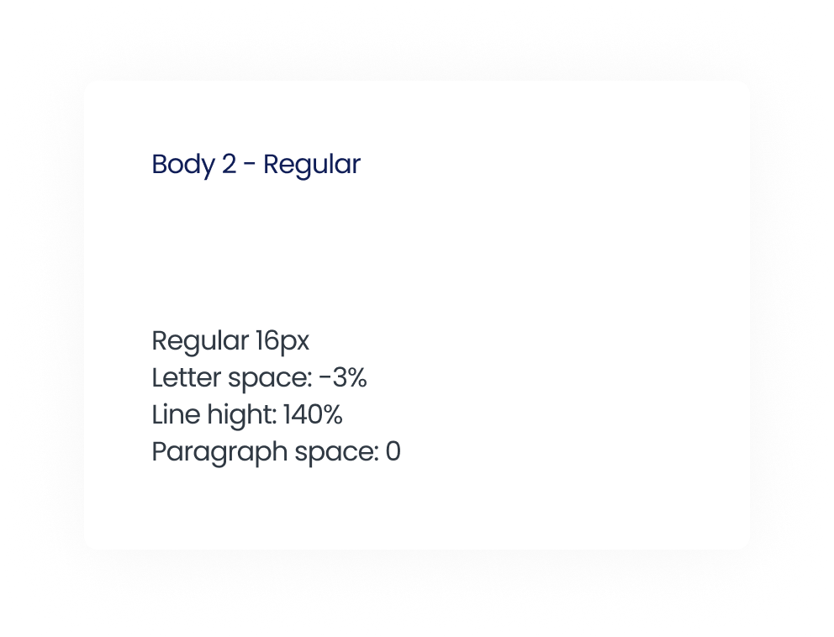
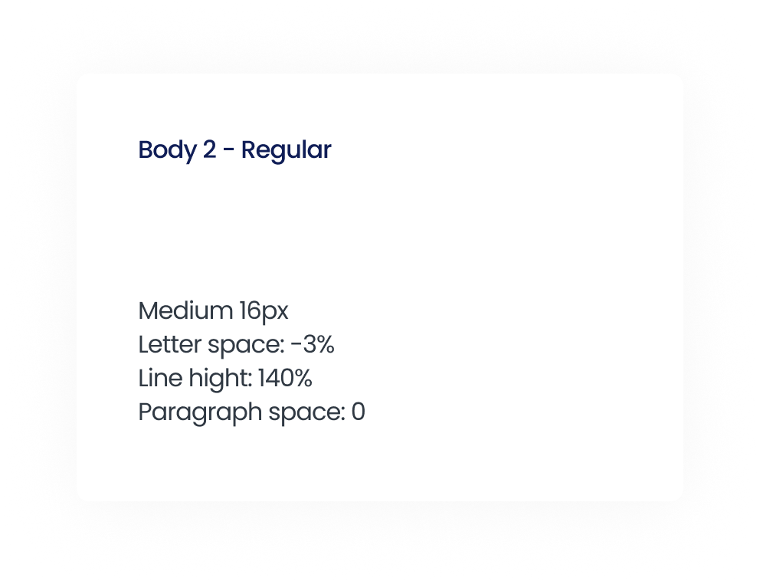
Typography
Poppins Font

Slide 10
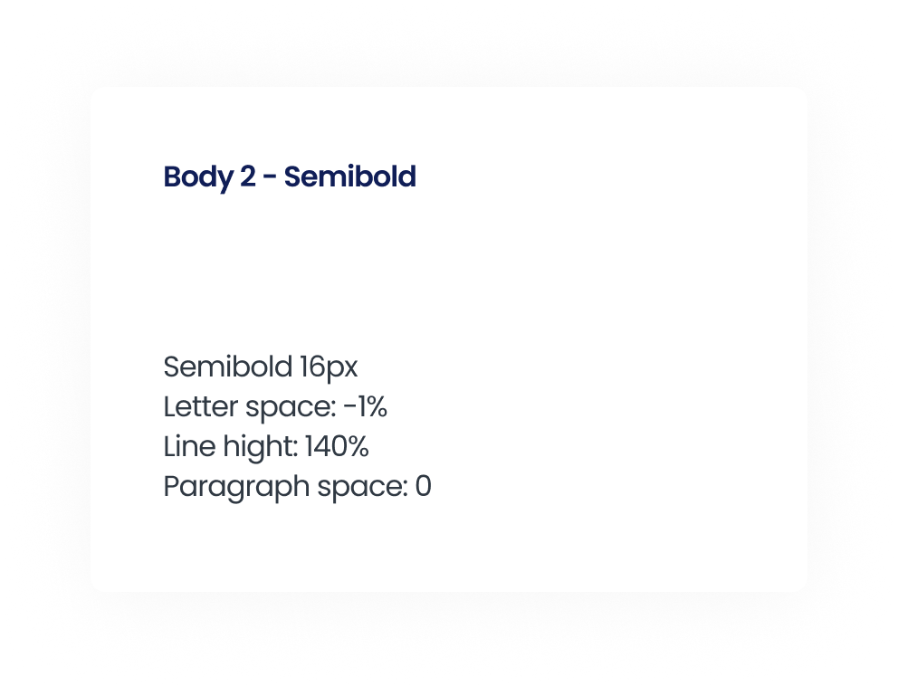
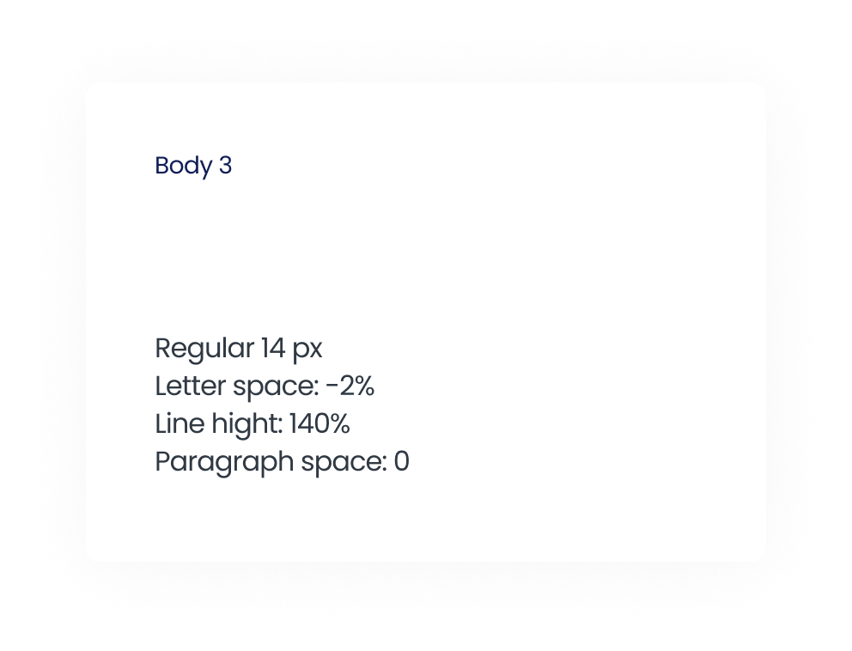
Typography
Poppins Font

Slide 11
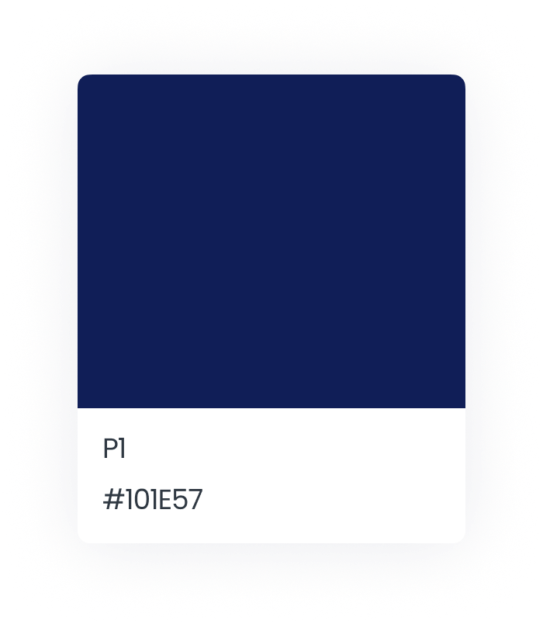
Colors
Primary - Headings & Text

Slide 12
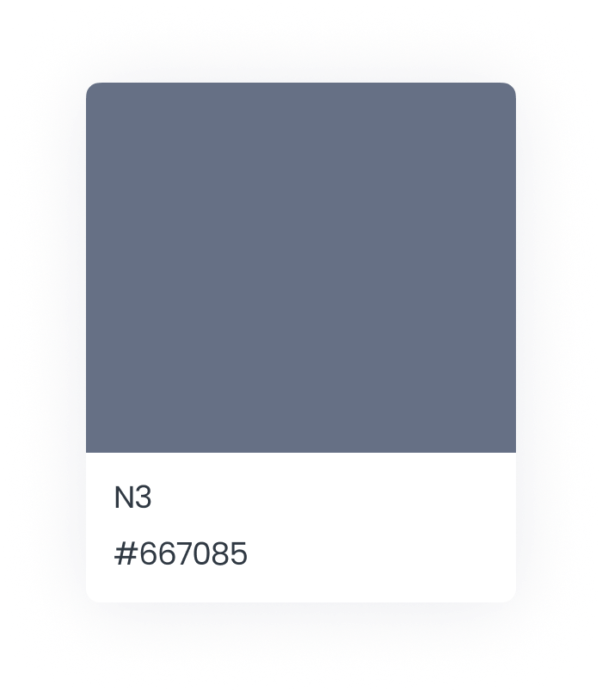
Colors
Primary - Sub-Text

Slide 13
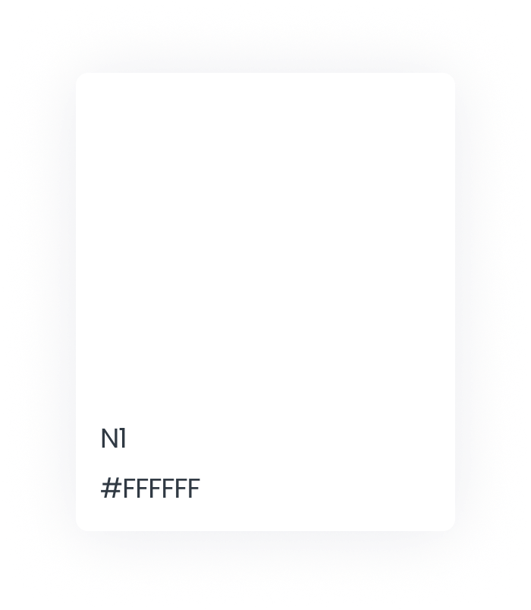
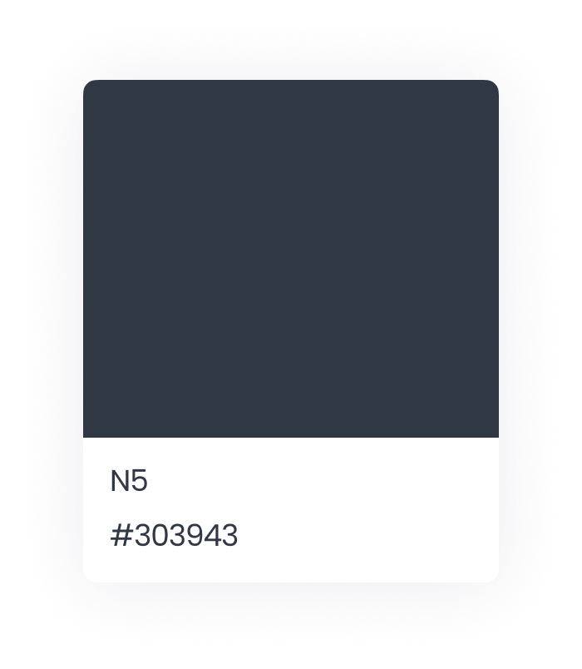
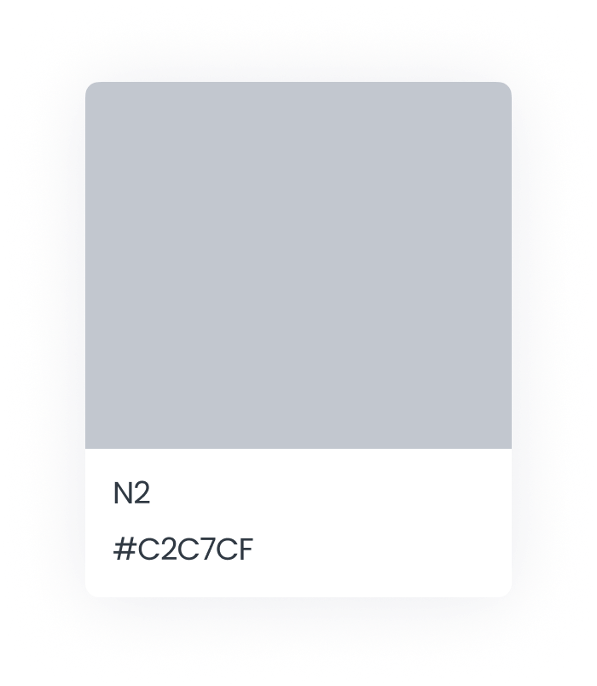
Colors
Neutrals

Slide 14
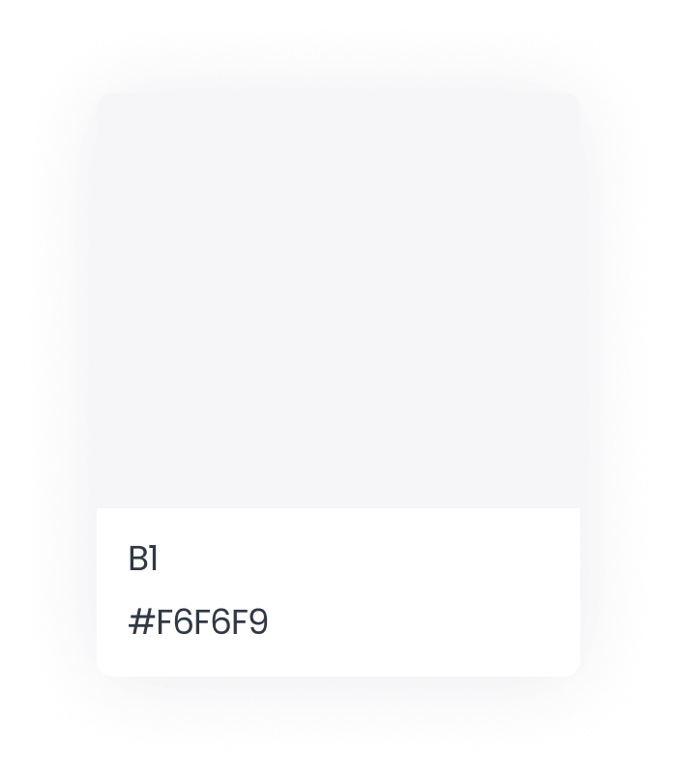
Colors
Background

Slide 15
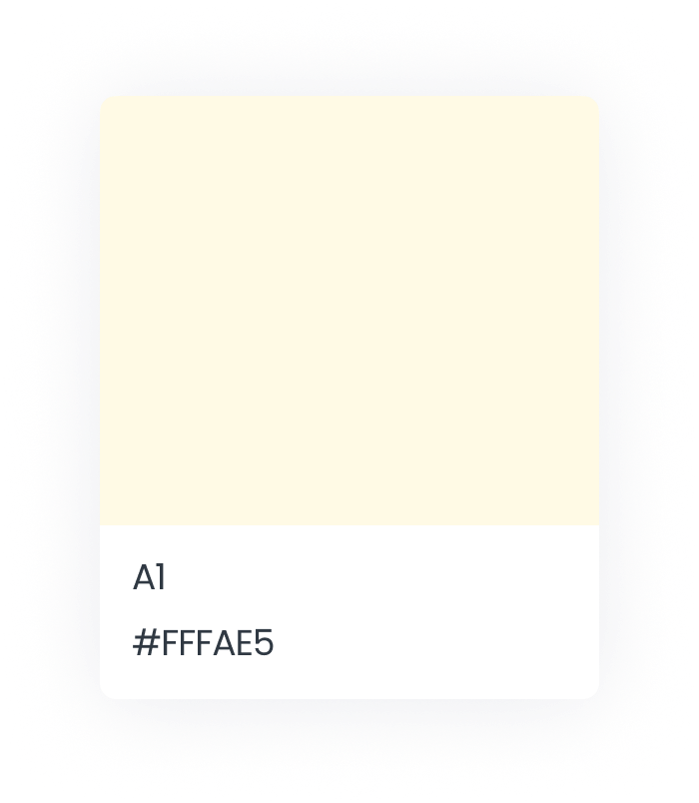
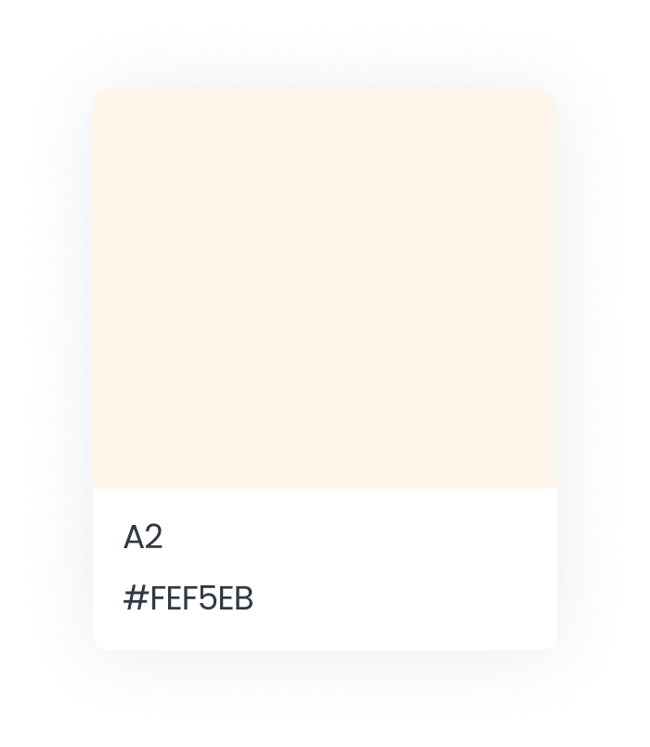
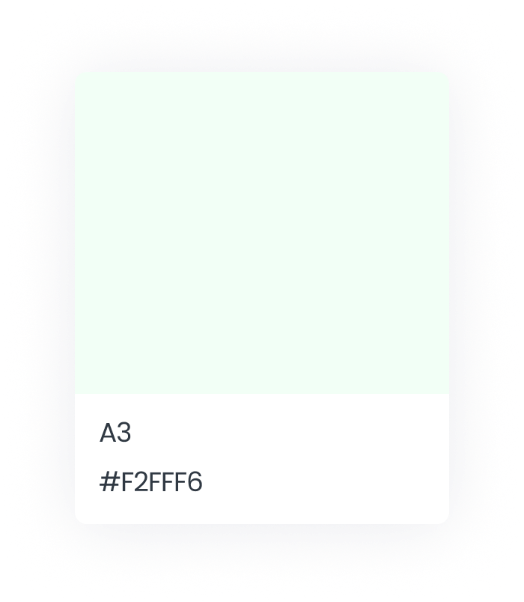
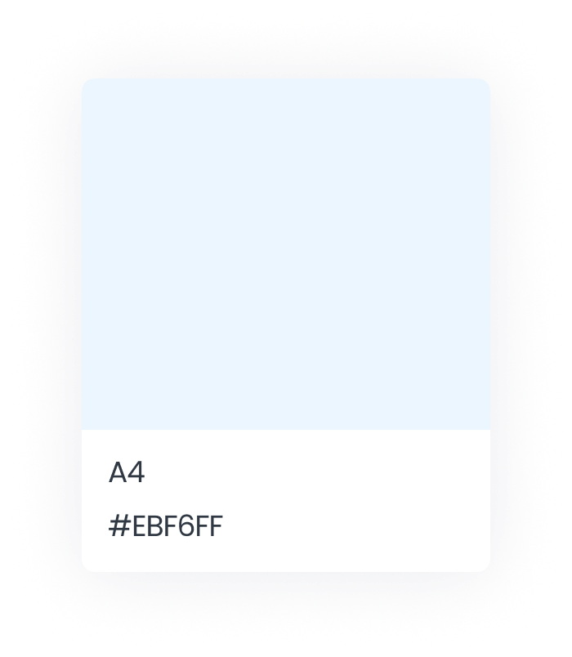
Colors
Accent

Slide 16
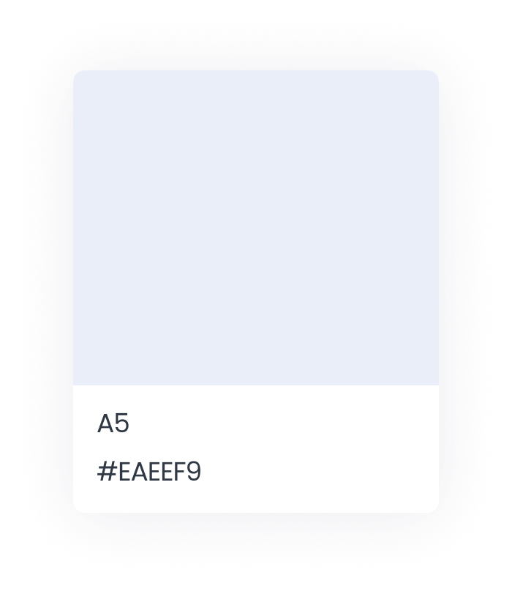
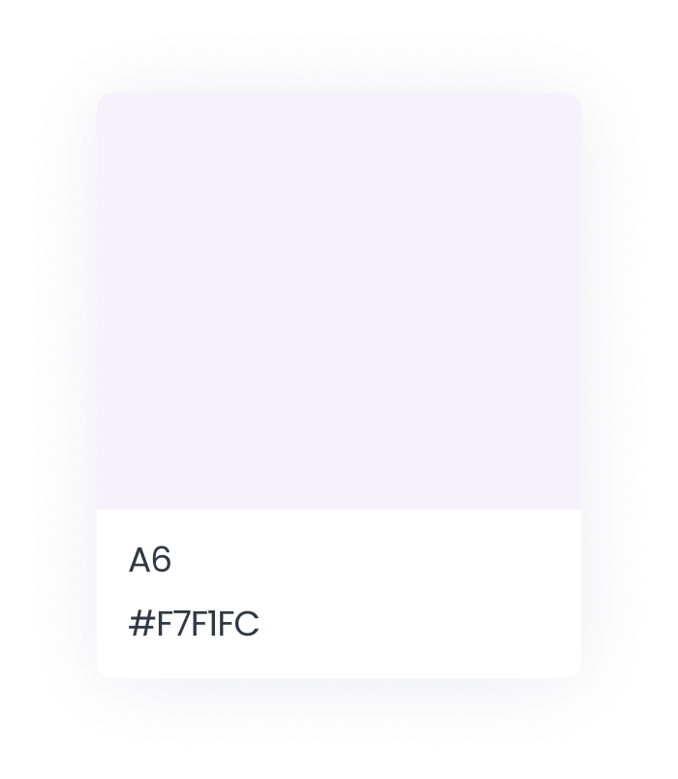
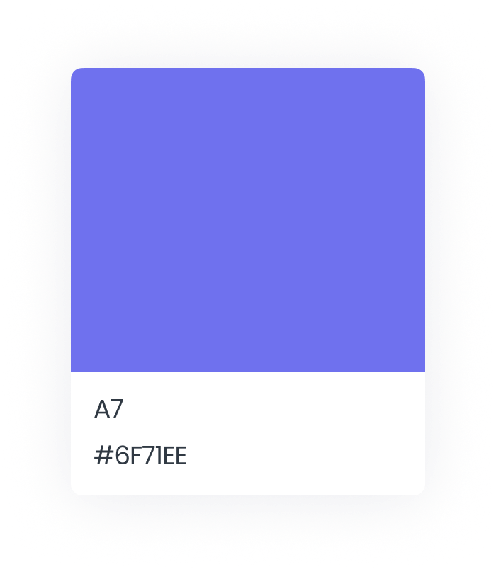
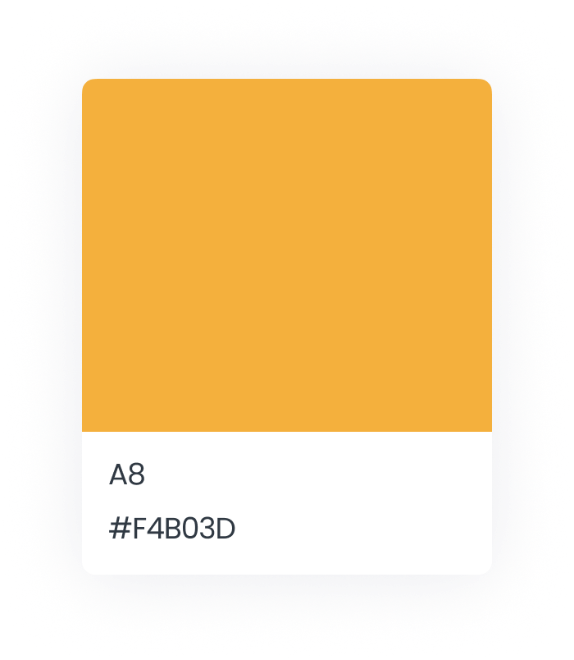
Colors
Accent

Slide 17
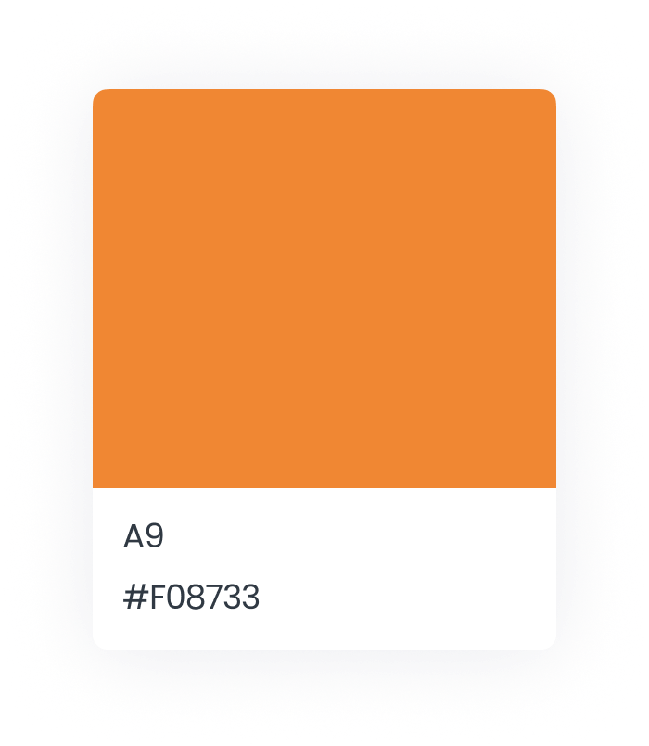
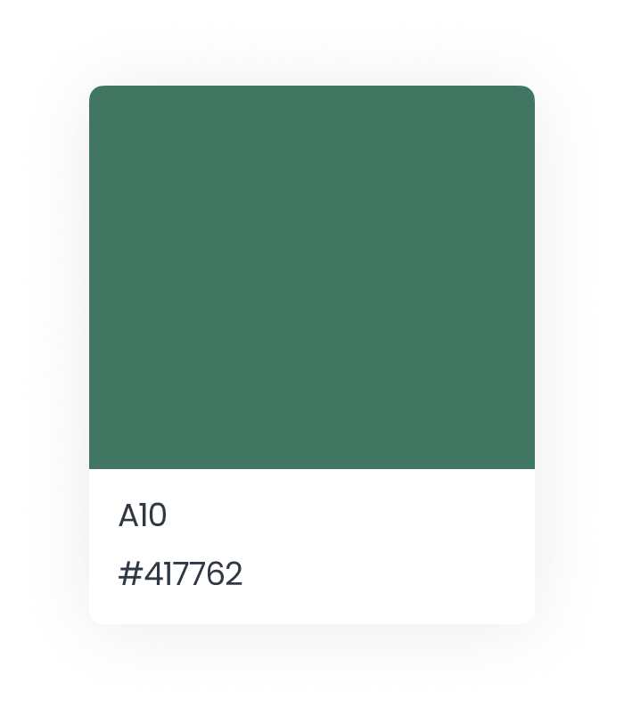
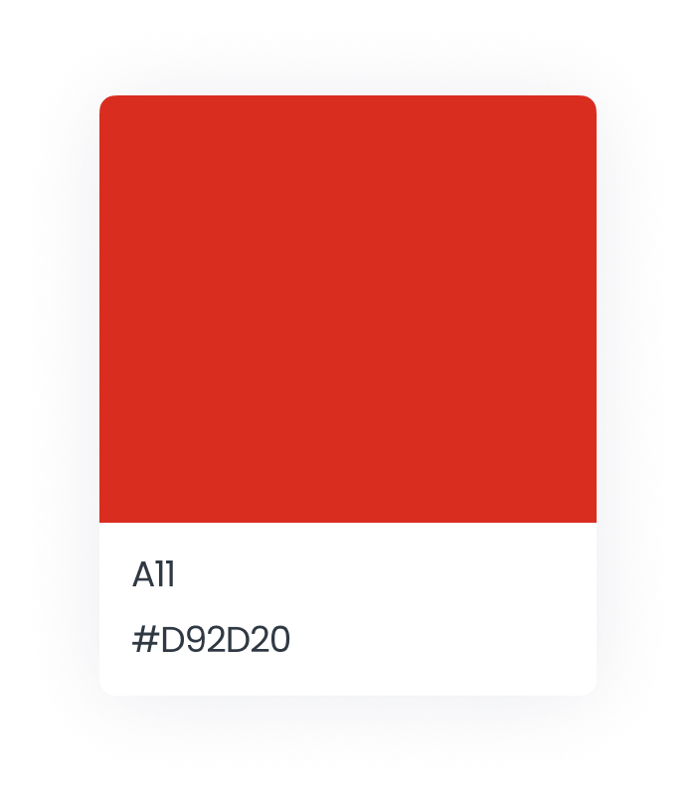
Colors
Accent

Slide 18
Sub-Text on Standard Background
Sub-Text on White Background
Heading on Standard Background
Heading on White Background
Primary Text on Standard Background
Primary Text on White Background

Slide 19
Sub-Text on Yellow Background
Sub-Text on Orange Background
Heading on Yellow Background
Heading on Orange Background
Primary Text on Yellow Background
Primary Text on Orange Background

Slide 20
Sub-Text on Green Background
Sub-Text on Green Background
Heading on Green Background
Heading on Green Background
Primary Text on Standard Background
Primary Text on Green Background

Slide 21
Sub-Text on Blue Background
Sub-Text on Blue Background
Heading on Blue Background
Heading on Blue Background
Primary Text on Blue Background
Primary Text on Blue Background

Slide 22
Sub-Text on Purple Background
Sub-Text on Pink Background
Heading on Purple Background
Heading on Pink Background
Primary Text on Purple Background
Primary Text on Pink Background

Slide 23
Sub-Text on Purple Background
Sub-Text on Orange Background
Heading on Purple Background
Heading on Orange Background
Primary Text on Purple Background
Primary Text on Orange Background

Slide 24
Sub-Text on Green Background
Sub-Text on Green Background
Heading on Green Background
Heading on Green Background
Primary Text on Green Background
Primary Text on Green Background

Slide 25




Signature
HTML Signature
<figure style="margin:0"><img src="https://info.whyliveschool.com/hubfs/Brand/liveschool-logo.png" width="130"/></figure><p style="margin-bottom: -10px; font-weight: bold; font-size: 18px; line-height: 100%;"><span style="color: #101e57;">Anna Murphy</span></p>
<p style="margin-bottom: -10px; font-size: 14px; line-height: 125%; font-weight: normal;"><span style="color: #101e57;">Director of Marketing</span></p>
<p style="margin-bottom: -10px; font-size: 14px; line-height: 125%; font-weight: normal;"><span style="color: #101e57;">anna@liveschoolinc.com</span></p>
<p style="margin-bottom: -10px; font-size: 14px; line-height: 125%; font-weight: bold;"><span style="text-decoration: underline;"><span style="color: #101e57;">whyliveschool.com</span></span></p>
Anna Murphy
Director of Marketing
anna@liveschoolinc.com
(503) 713-3917
whyliveschool.com

Slide 26









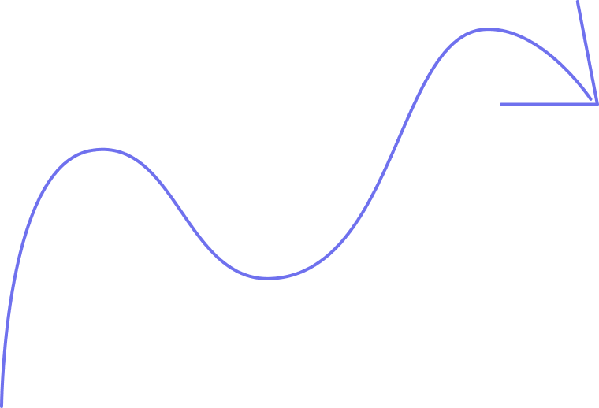






Arrows

Slide 27















Arrows

Slide 28
Creeping Lines

Slide 29
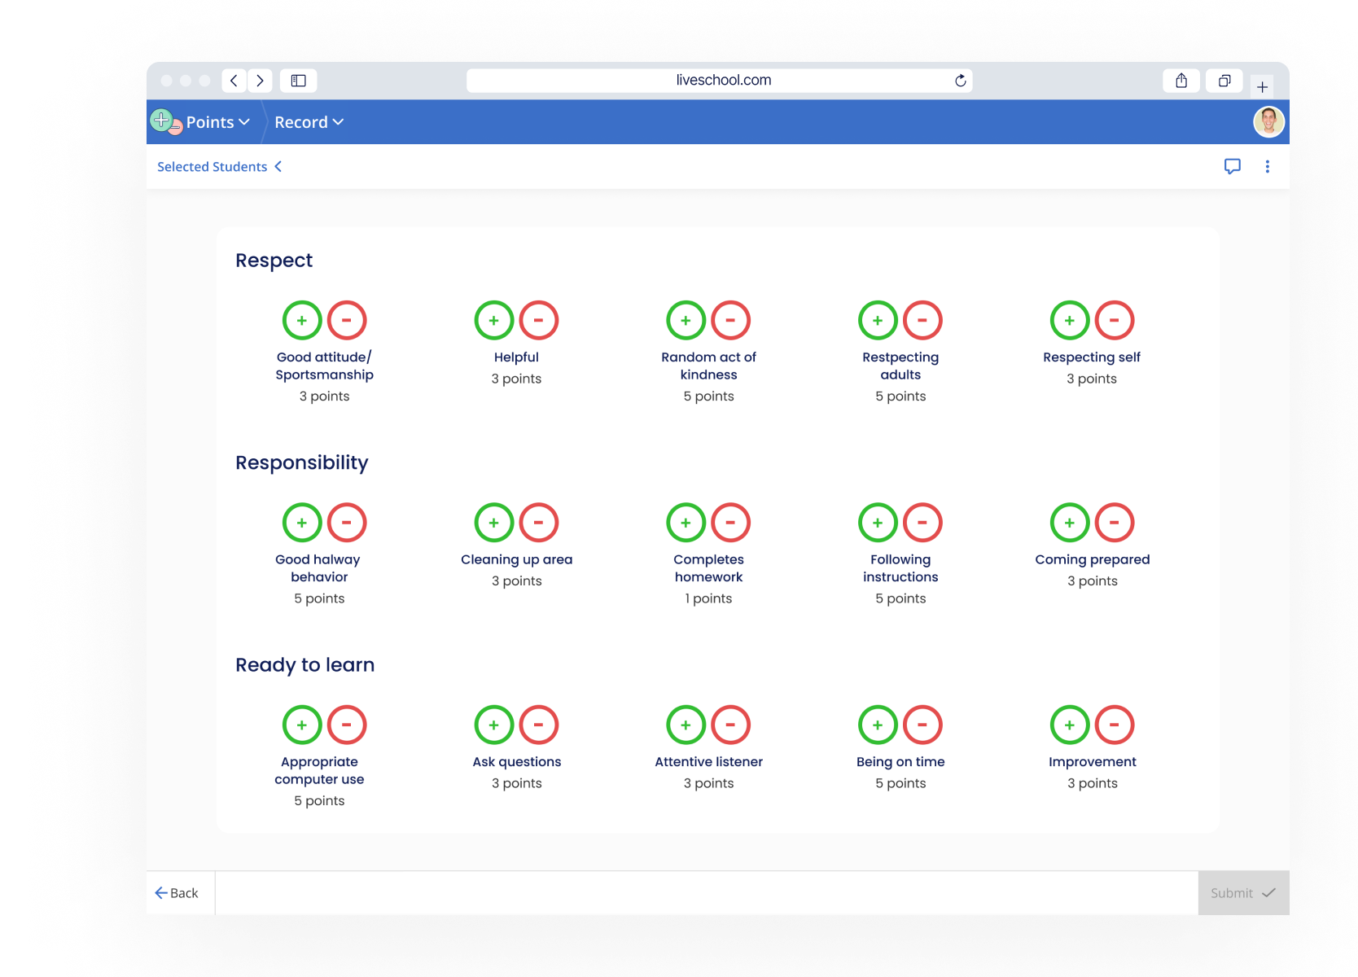
Product Mockups
Points Tracking

Slide 30
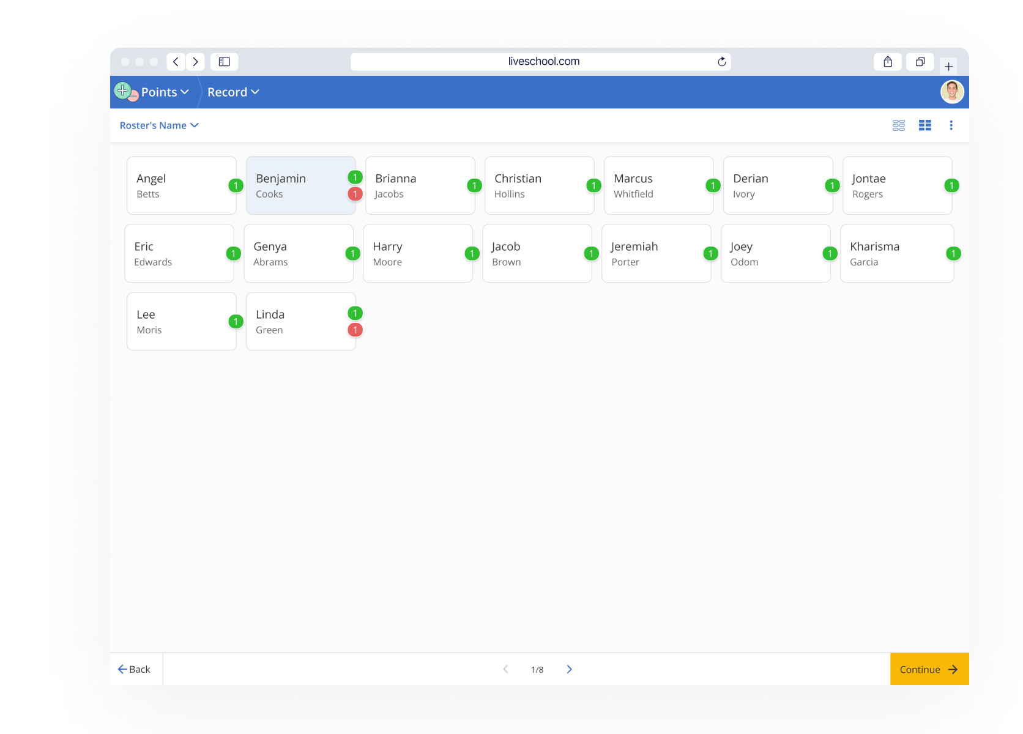
Product Mockups
Points Tracking

Slide 31
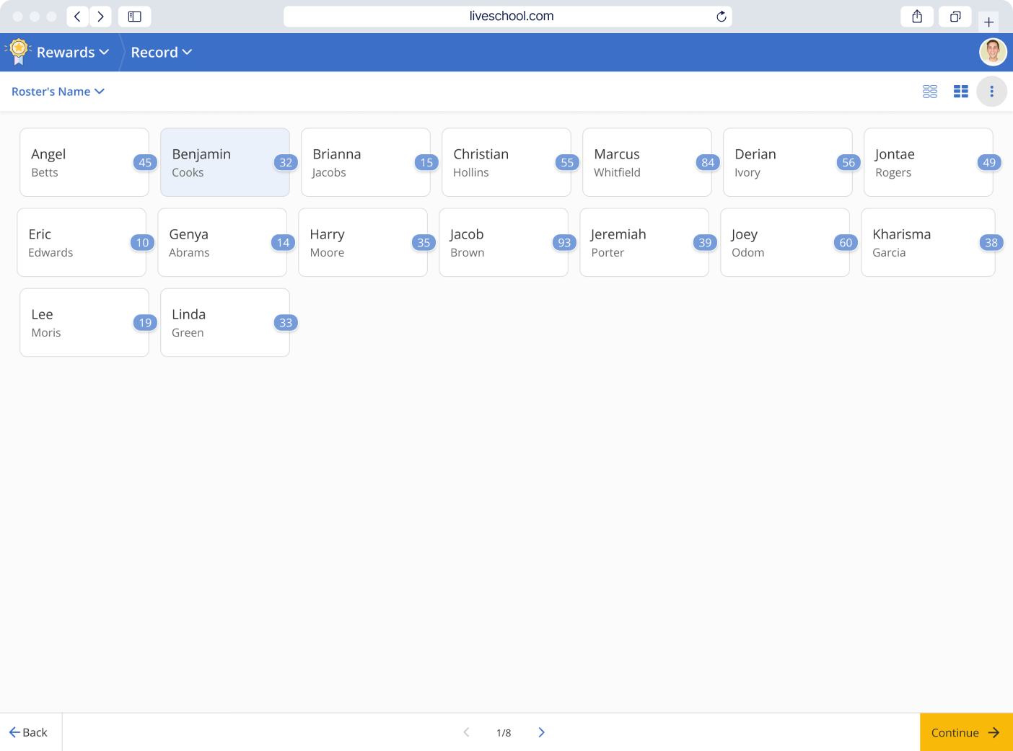
Product Mockups
Points Tracking

Slide 32
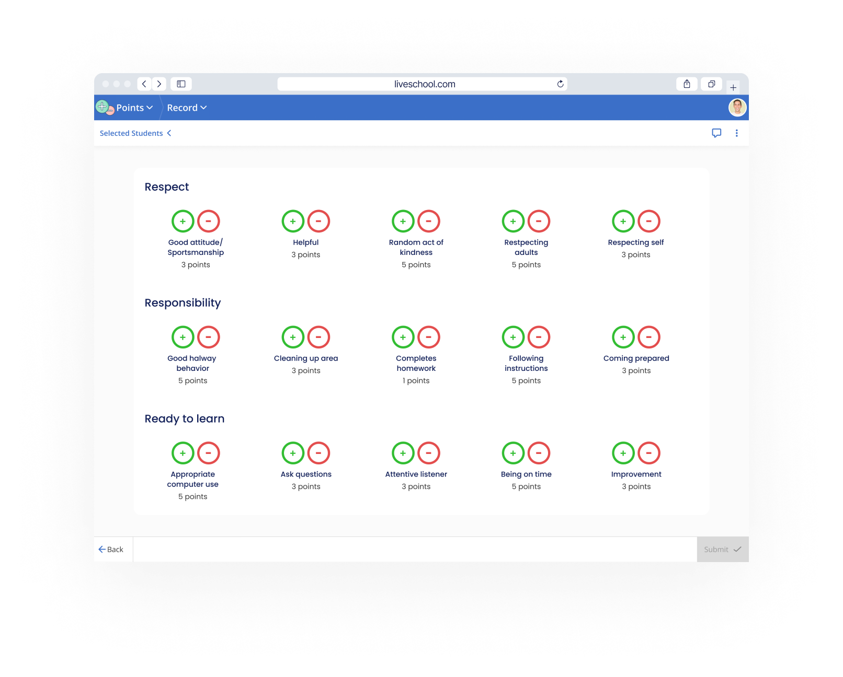
Product Mockups
Rubric

Slide 33
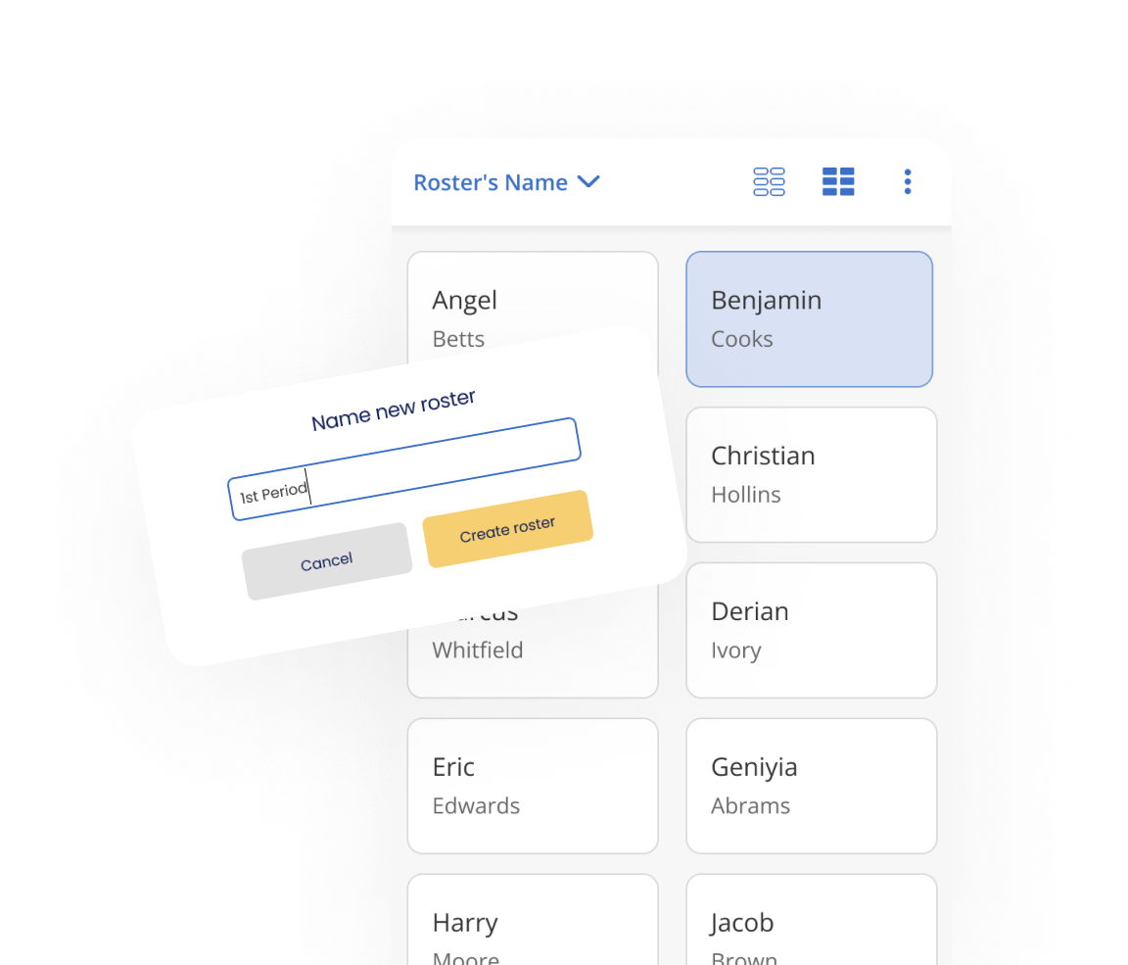
Product Mockups
Rosters

Slide 34
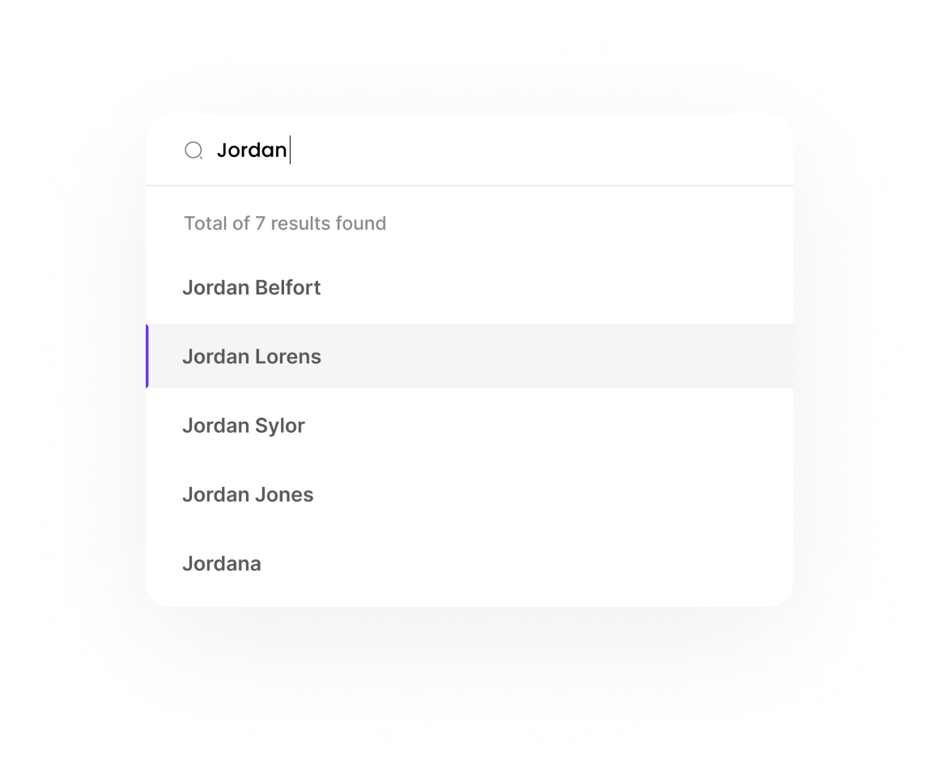
Product Mockups
Student Search

Slide 35
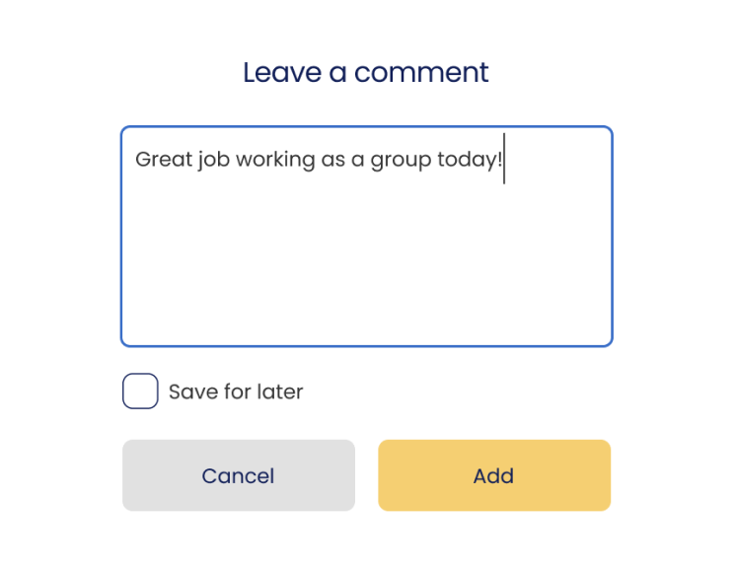
Product Mockups
Comments

Slide 36
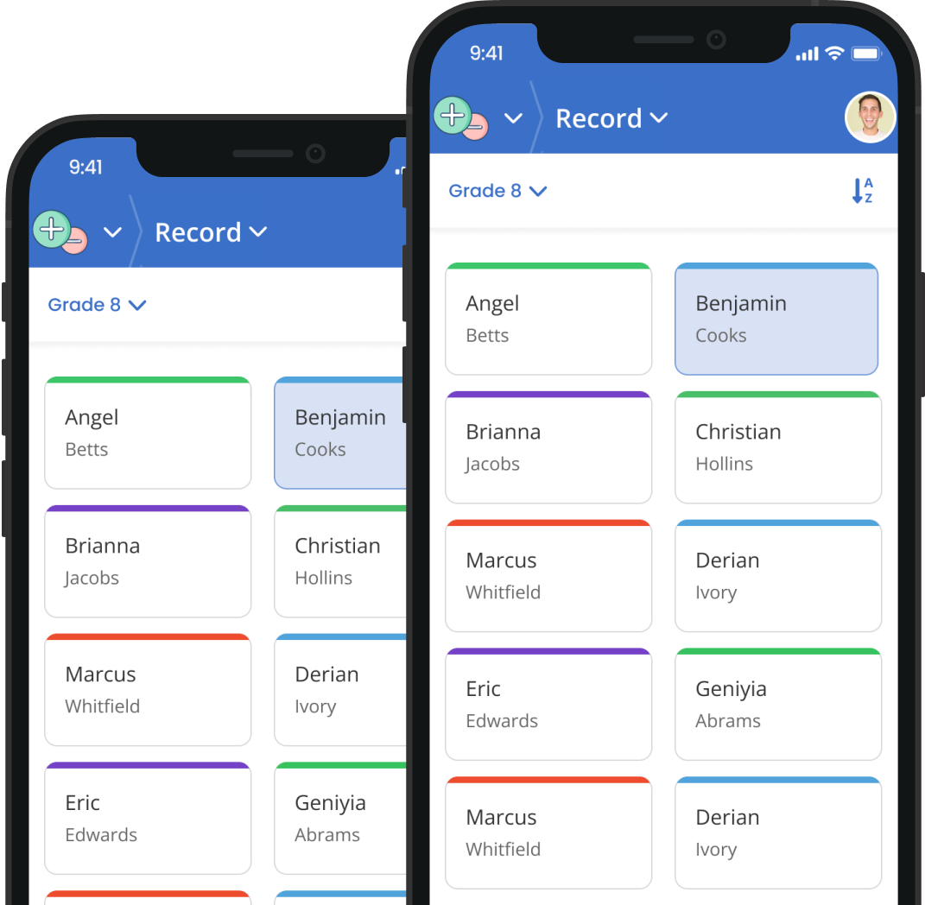
Product Mockups
House Colors

Slide 37
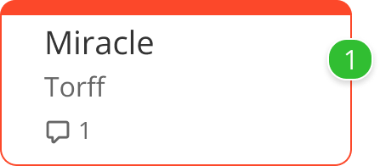
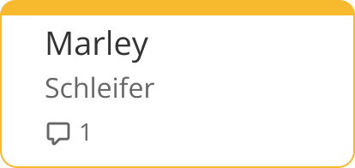
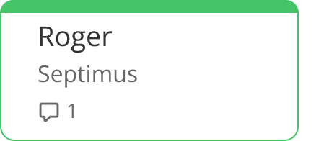
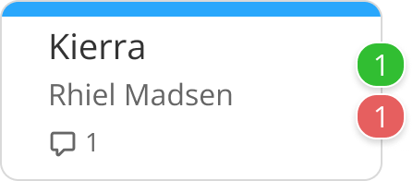
Product Mockups
House Colors (Individual)

Slide 38
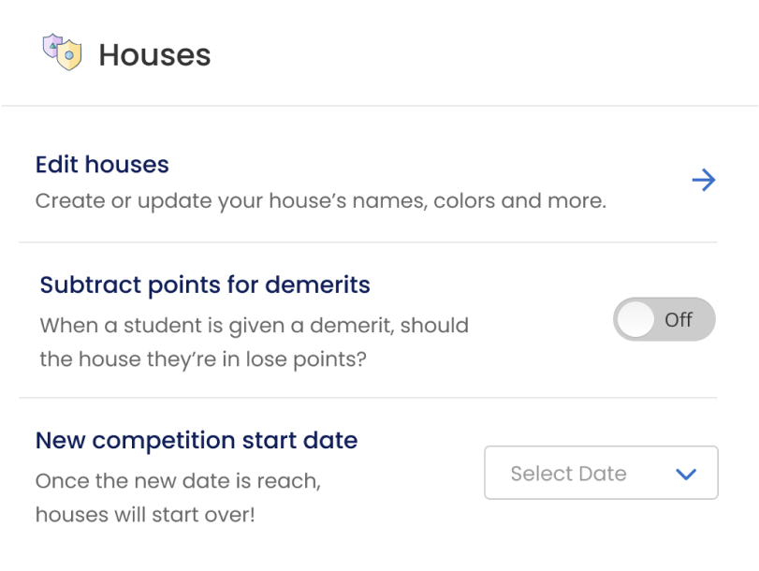
Product Mockups
House Set-up

Slide 39
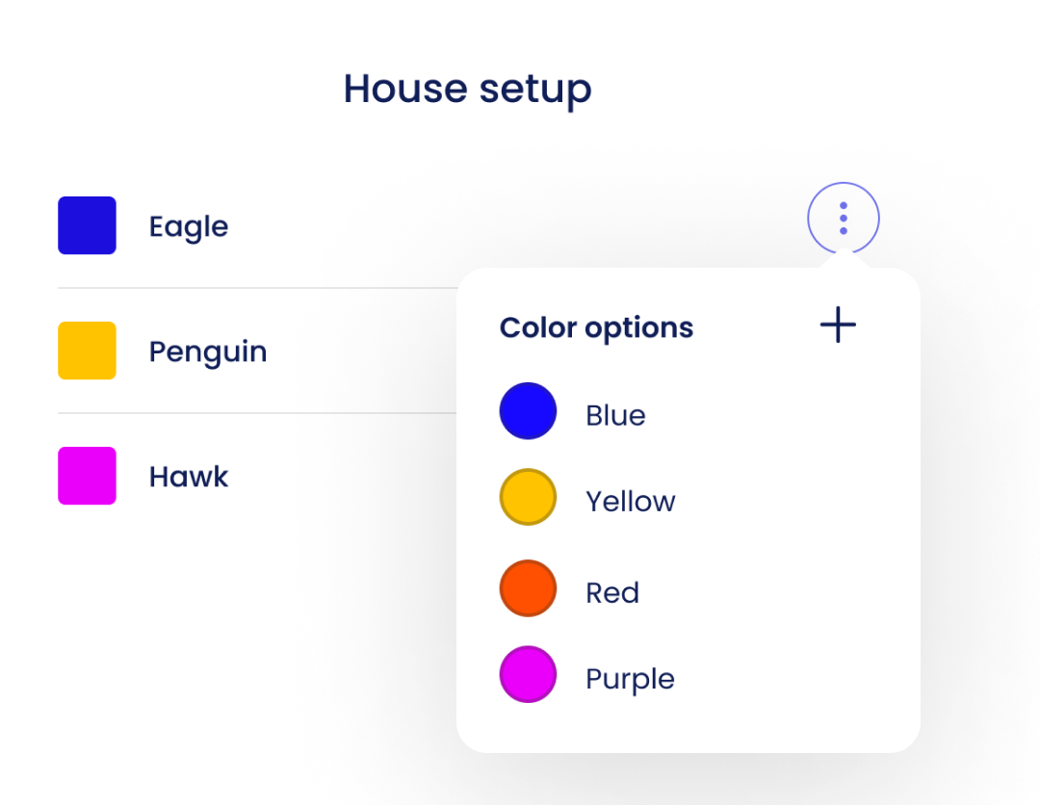
Product Mockups
House Set-up (Colors)

Slide 40
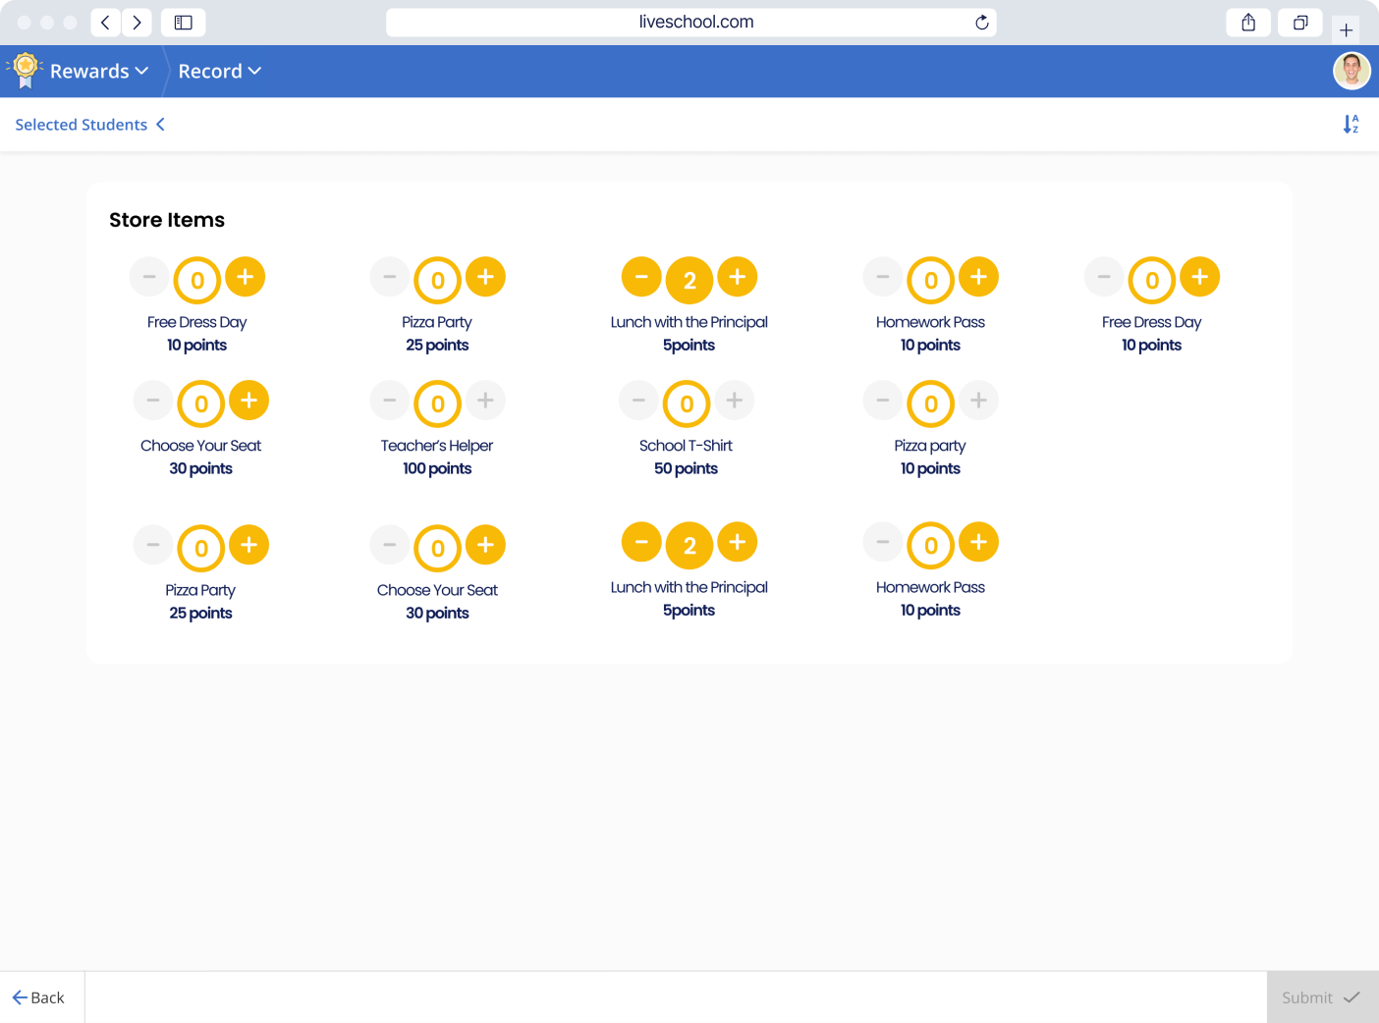
Product Mockups
Rewards Store

Slide 41
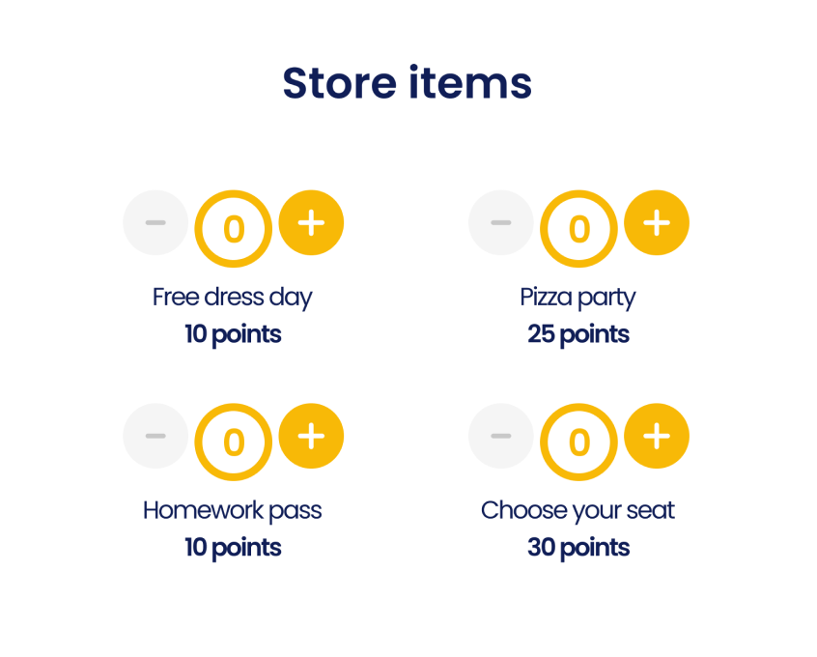
Product Mockups
Rewards Store (Small)

Slide 42
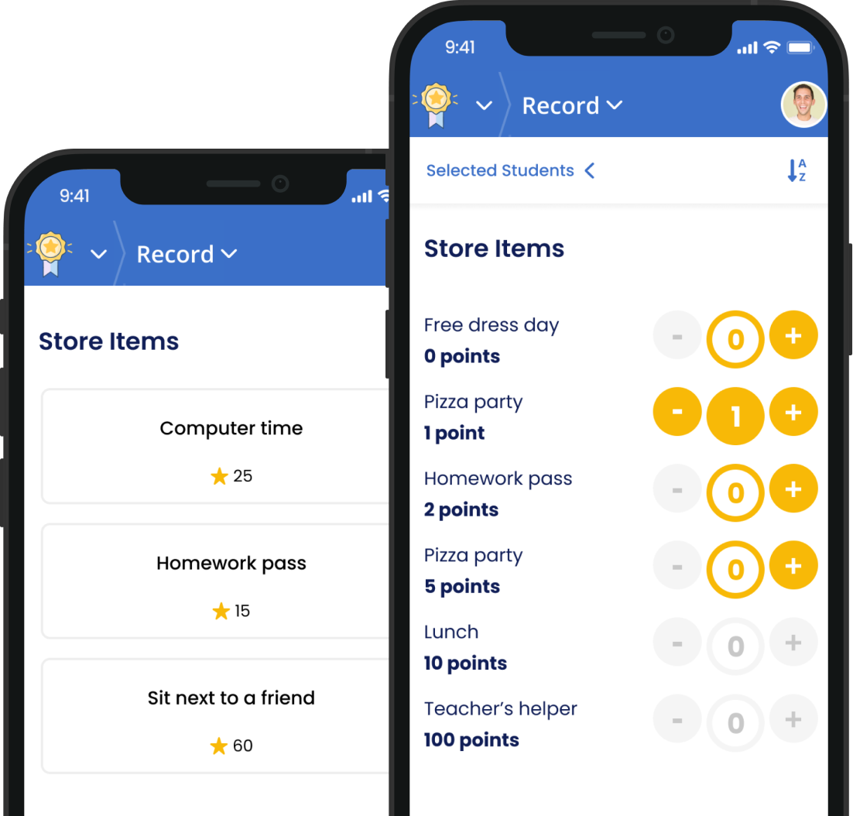
Product Mockups
Rewards Store (Phone)

Slide 43
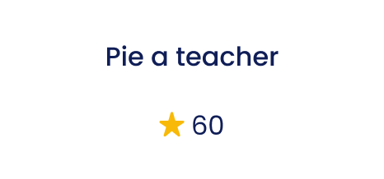
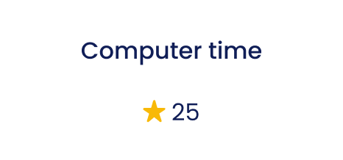
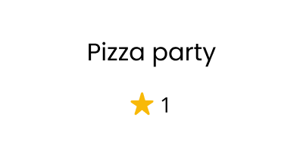
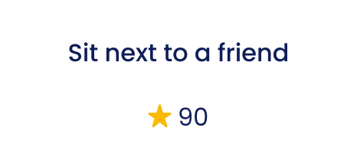

Product Mockups
Rewards Store (Individual Items)

Slide 44

Product Mockups
Insights (Teacher Dashboard)

Slide 45

Product Mockups
Insights (Teacher Dashboard - Small)

Slide 46

Product Mockups
Insights (Timeline)

Slide 47

Product Mockups
Insights (Top Rewards)

Slide 48

Product Mockups
Insights (Top Behaviors)

Slide 49

Product Mockups
Insights (Spending)

Slide 50

Product Mockups
Insights (General Dashboard)

Slide 51

Product Mockups
Recaps

Slide 52

Product Mockups
Recaps (Phone)

Slide 53

Product Mockups
Recaps (Phone)

Slide 54

Product Mockups
Recaps (Email)

Slide 55

Product Mockups
Recaps (Set-up)

Slide 56

Product Mockups
Recaps (Set-up small)

Slide 57

Product Mockups
District Dashboard

Slide 58




Product Mockups
Pop-Ups

Slide 59
Photos
Goodlettsville HP →
Jerre Baxter Photo Shoot →
Summit →

